Slide 1
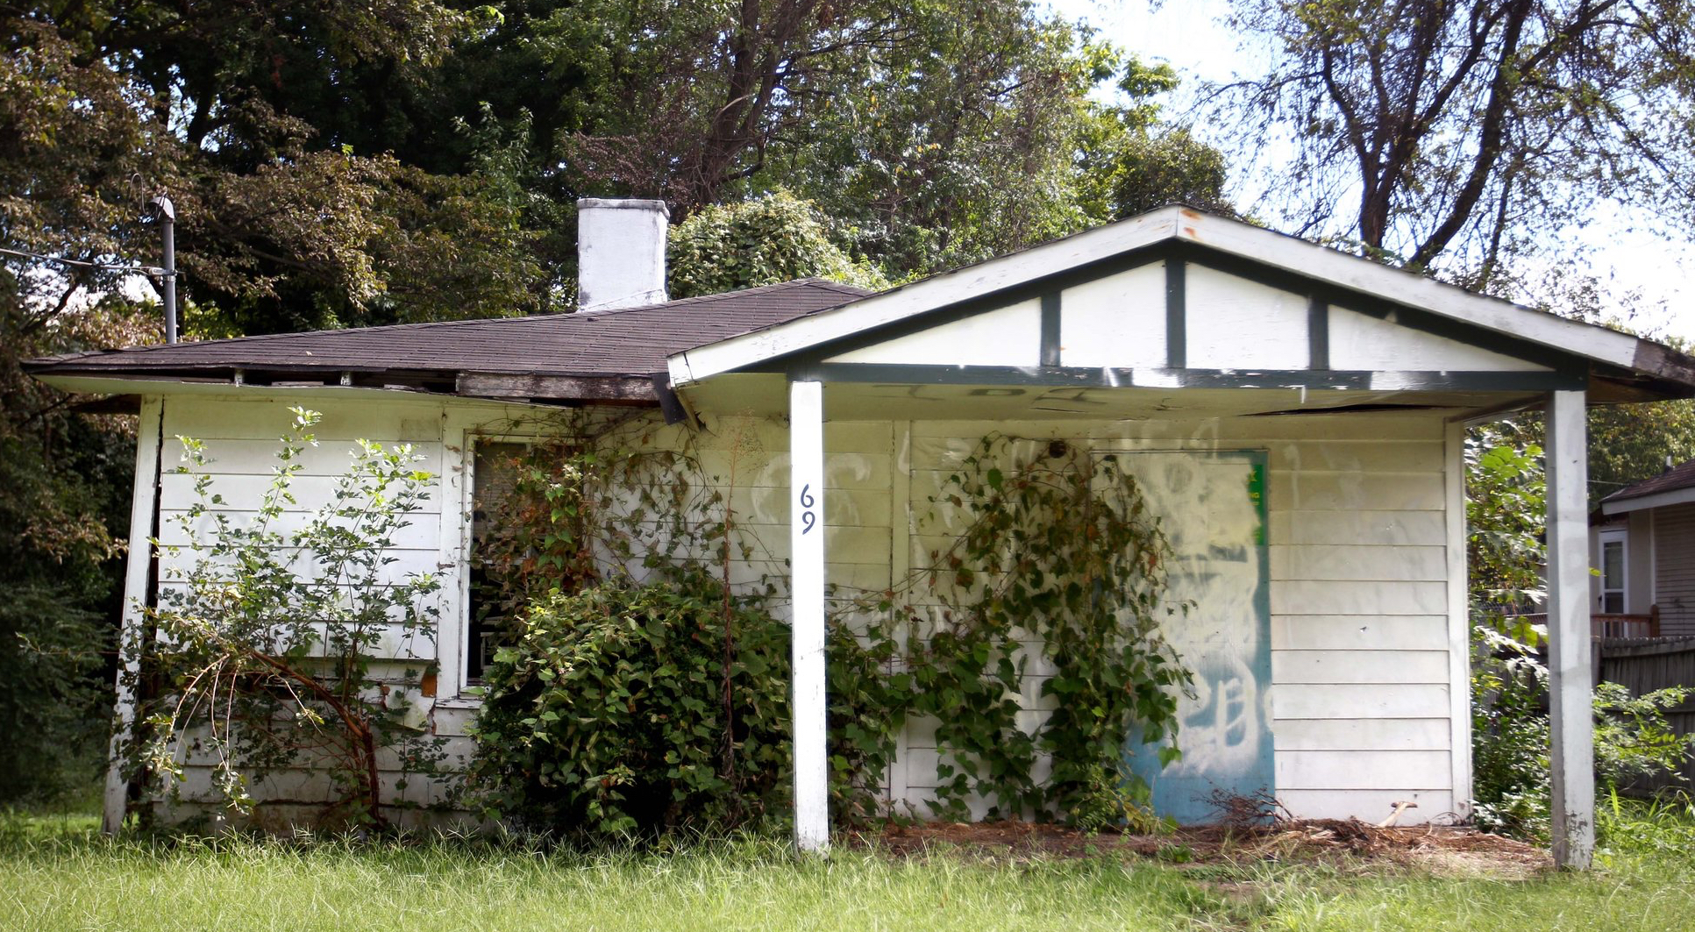
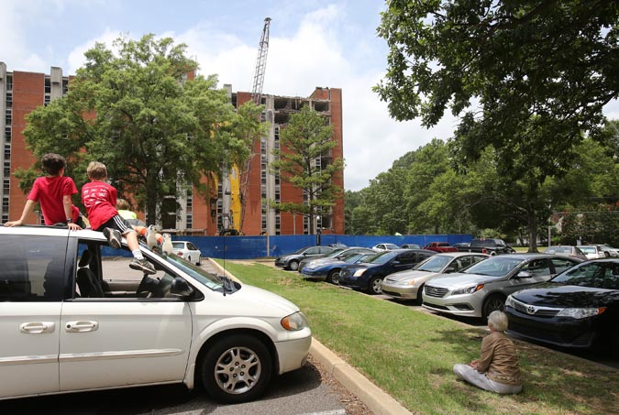
Blight Property

Slide 2
Agenda
Background
Introduction and goal
Data source and description
Key challenges
Descriptive analysis(tableau)
Predictive analysis(SAS EM)
Key Learnings

Slide 3
Background of the blight property
Blight: abandoned and/or vacant property, either building or home, that is in an unacceptable condition of disrepair. It is inhabitable and has little to no economic value.
Background:
US is facing the problems of empty neighborhoods across the country. We can see similar problems in Memphis, TN, and the causes for this are: Poor planning, Poverty and Sub Urbanization are the causes of the Urban Blight. The problems are caused because of – Unemployment, depopulation problems, promote crime, loss of deindustrialization. Blight affected areas are characterized by dirty, cloistered, tumbledown buildings and inhospitable living.
Effects of such properties
Danger to the public
Increase in negative incidents
Negative effect on surrounding property values
Reduces property tax revenue

Slide 4
Business objective and project goal
Business objective:
Identify properties that are possible to become blighted. This information can help local community and government plan in advance and minimize the bad effects of a blighted property/area.
Project goal
Identify the data that are more related to to blight property, characterize their relationships and predict the possibility that a property turn into a blight property
Approaches
Use demolition fees as an indicator of blight properties.
Explore relevant data (i.e., crime, sales, blight rating, property tax etc.) with tableau, and try to find the data related to blight property and explore their relationships.
Explore the data with SAS EM to further characterize the relationships between the relevant data and the target and predict the possibilities.

Slide 5
Data source and description
Datasets | Content of each data set
Windshield | The thorough housing information , condition details of all the Memphis and Shelby property, and Memphis and Shelby county regulation and code enforcement, ~150,000 parcel ID. The data set was not cleaned
Tax aggregation | 32 statement records of aggregated (sum) of property tax information over the period of 2010-2016, 46,751 parcel ID, data collected from 2010 to 2016.
MLGW aggregation | count how many times MLGW cut off the supply to one property. Interval (discrete) data with data range [0, 2], two types of data recorded (gas cut and electricity cut) per year for 15,678 parcel ID
Sales aggregation | count how many times sale happens each year. Interval (discrete) data with data range [0, 27], one sale record of each year for 127,609 parcel ID
Crime aggregation | count how many crimes happen on each property. Interval (discrete) data with data range [0, 447], three types of crimes(violent, nonviolent, other) document for each year; 98,366 data point
Data processing approach and flow for further analysis:
Randomly sampling parcel IDs in the tax aggregation data and compare the tax value with the information on the Shelby county trustee website
Select the tax aggregation data from a year that has the most data points documented
Clean up all types of errors in the Windshield data
Convert Parcel IDs in the above five datasets into the same format.
Inner joined all the dataset and create a dummy variable for demolition fees.
Target variable: demolition dummy variable
Input variables for SAS EM:
1st round, all the variables from the above data set except for unary data, ID, zip code and data missing over 50%
2nd and the later round, all the variables that have the P value lower than 0.6 in the regression model statistics

Slide 6
Key Challenges
Data challenges:
Data cleaning, the windshield data provide useful details of housing conditions but it is very messy. It took about 8 hours to clean it to a useful/informative level.
The inaccuracy of some given datasets requires to examine the data using higher authority data source, which was not expected when the project started.
Need domain knowledge of housing, and Shelby county regulation to understand the meaning and value of related variables and manipulate the input without biasing the modeling process.
Too many variables for EM regression models and missing values in a high dimension dataset
Data techniques:
Descriptive analysis with Tableau
Joint or merge datasets, Query and computing in SAS EG
Decision trees, regression and neural network modeling with SAS EM

Slide 7
Descriptive Analytics
Analyze datasets to get basic understanding of simple statistics
Define the most affected zoning districts
Analyze and explore relationship between Crime, Sales, Gas/Power cuts, property tax and demolition fees.
Total Crime 2010 - 2015

Slide 8
Violent, Non Violent, Other Crime by Zones

Slide 9
Crime (2010 – 2015) by Zones

Slide 10
Gas/Power Cuts by Zones

Slide 11
Blight Rating by Zones

Slide 12
Demolition Fees by Zones

Slide 13
Original Demolition Fees vs. Paid Fees

Slide 14
Combined Fees Due

Slide 15
Combined Fees vs. Paid Fees

Slide 16
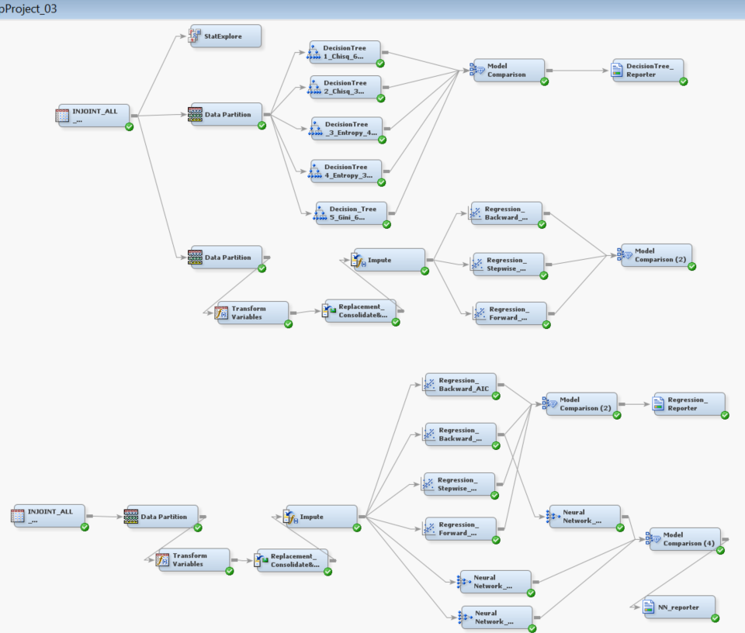
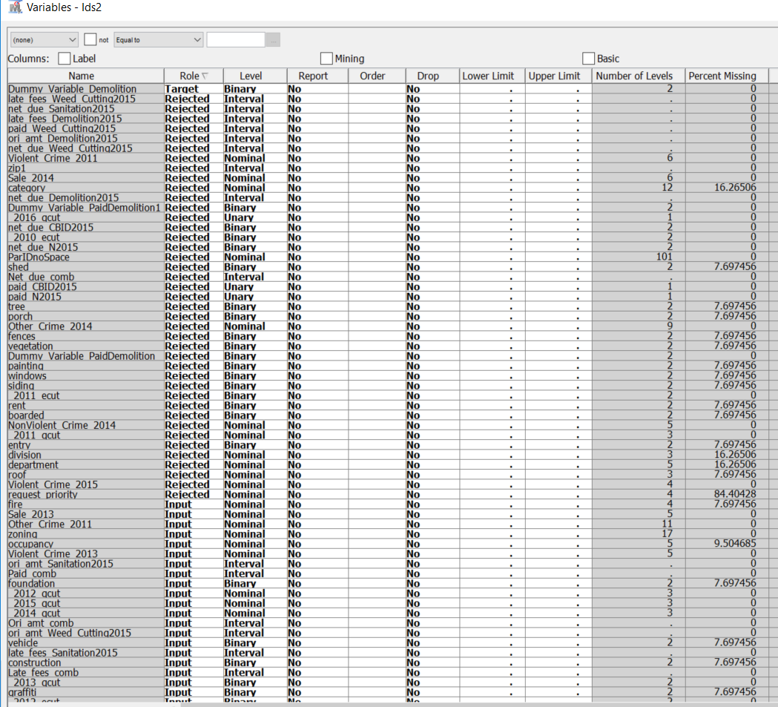
Predictive Analytics
The Diagram of decision trees, regression and NN models
An iterative selection approach to select independent variables

Slide 17
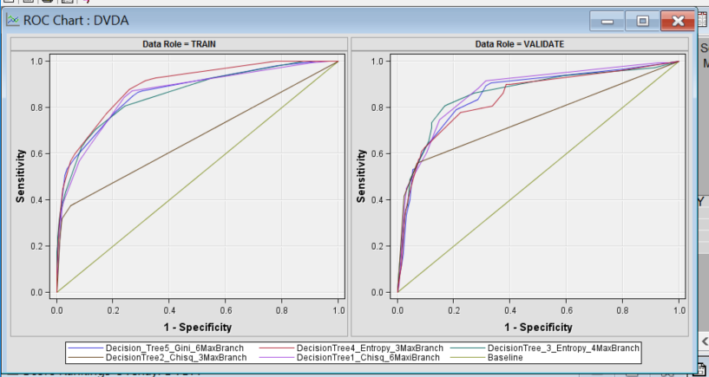
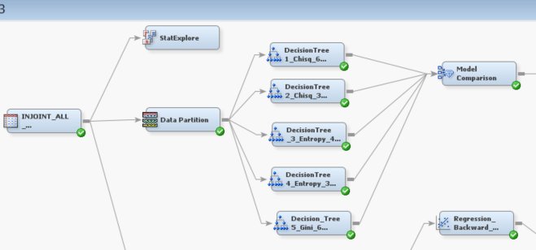
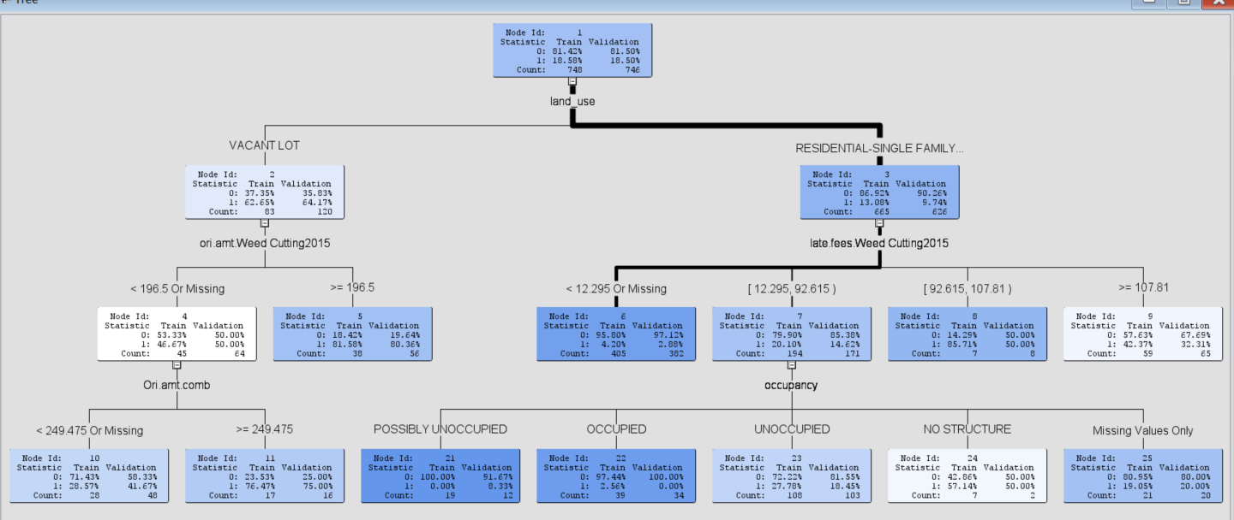
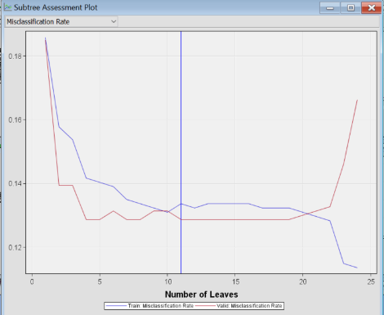
Decision tree model comparison and statistics
Valid Train
Model Misclassification
Node Model Description Rate
Tree DecisionTree1_Chisq_6MaxiBranch 0.12869 0.13369
Tree2 DecisionTree2_Chisq_3MaxBranch 0.12869 0.14171
Tree3 DecisionTree_3_Entropy_4MaxBranch 0.13137 0.13102
Tree5 Decision_Tree5_Gini_6MaxBranch 0.13271 0.11631
Tree4 DecisionTree4_Entropy_3MaxBranch 0.14075 0.12032

Slide 18
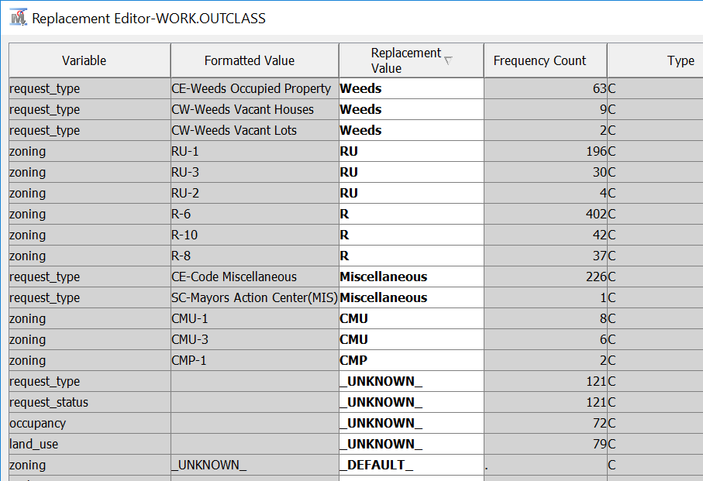
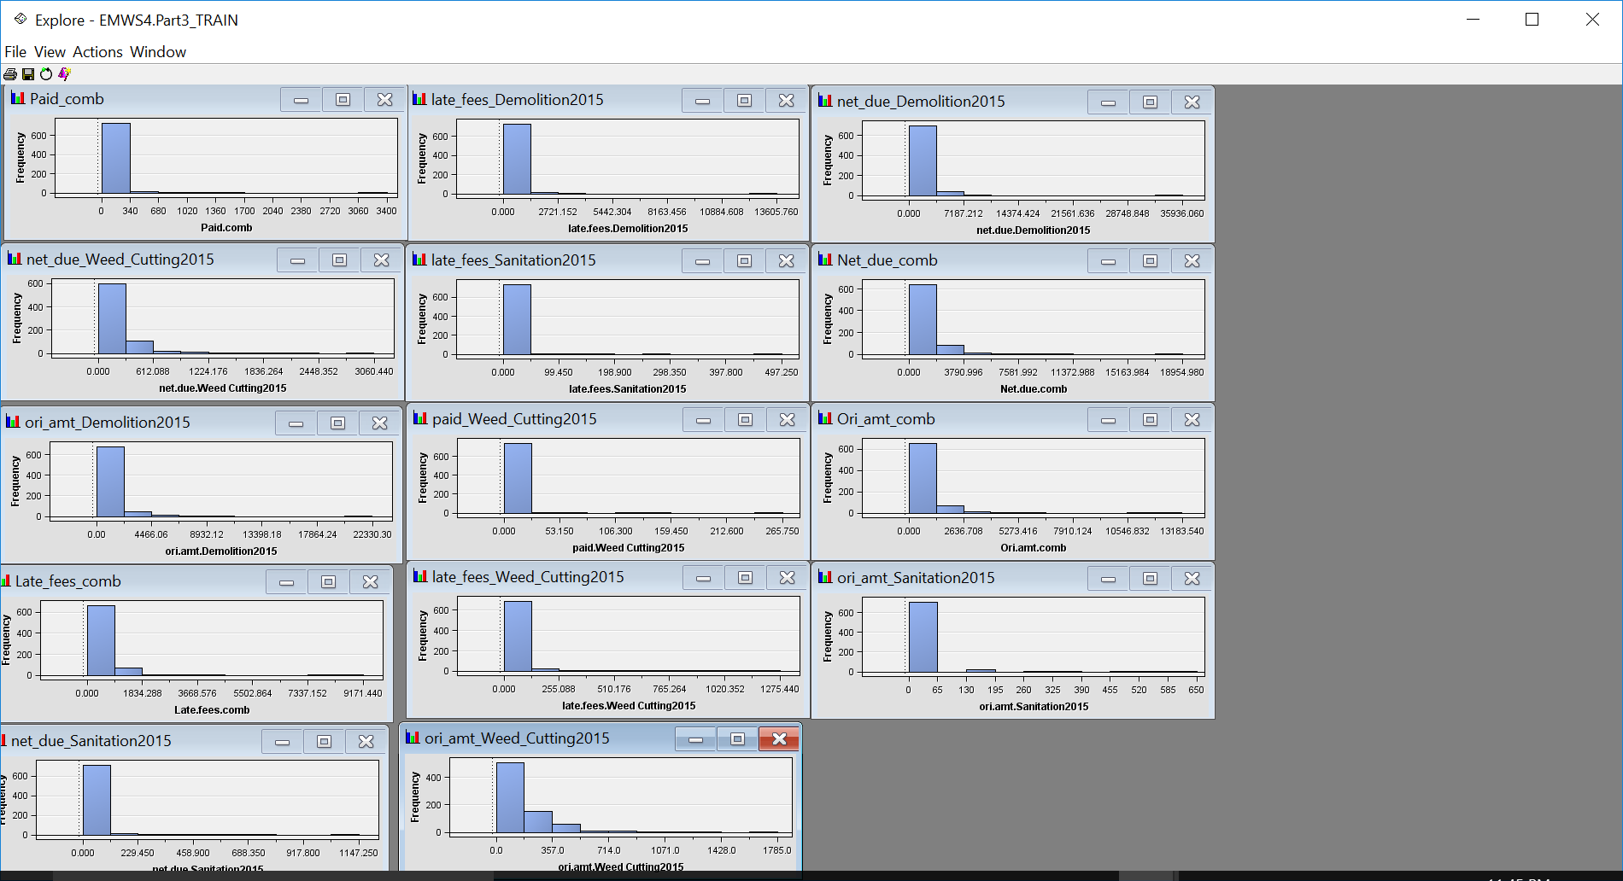
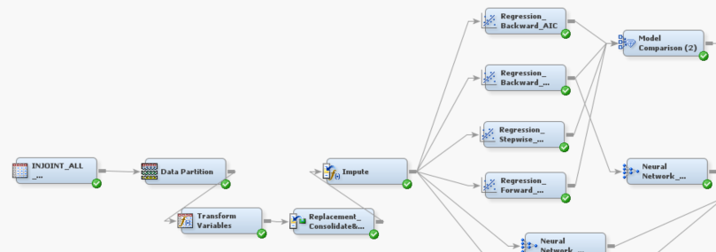
Data transformation and replacement for regression models
References for variable level replacement:
The Memphis and Shelby county zoning code and subdivision regulation
https://shelbycountytn.gov/DocumentCenter/View/27740
The Memphis and Shelby county major code violation
https://www.shelbycountytn.gov/2138/Major-Code-Violations

Slide 19
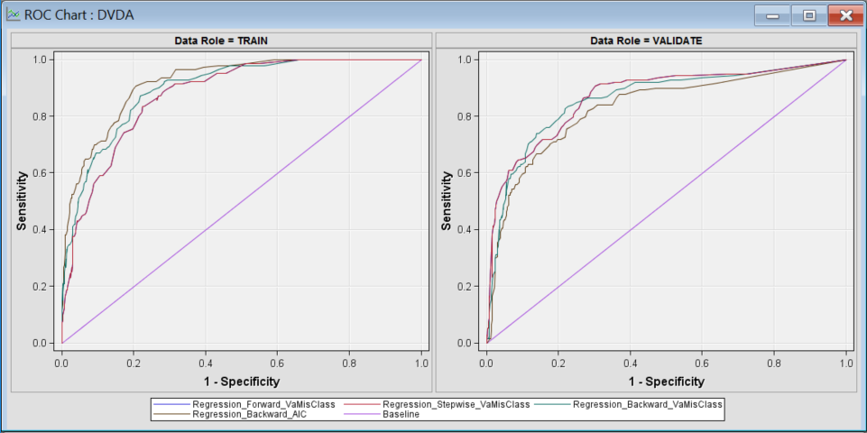
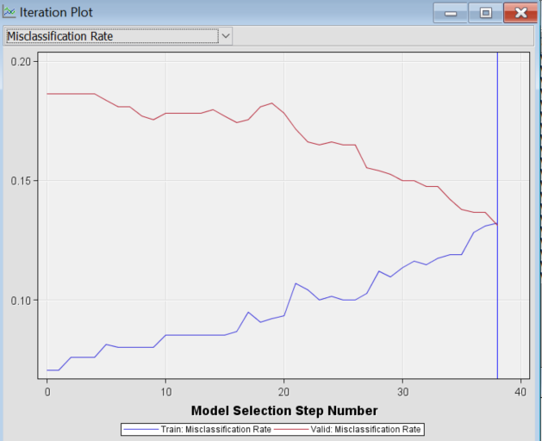
Regression model comparison and statistics
Valid Train Model Misclassification
Node Model Description Rate
Reg6 Regression_Stepwise_VaMisClass 0.11796 0.14305
Reg7 Regression_Forward_VaMisClass 0.11796 0.14305
Reg5 Regression_Backward_VaMisClass 0.13137 0.13235
Reg4 Regression_Backward_AIC 0.14745 0.11765
Type 3 Analysis of Effects
Wald
Effect DF Chi-Square Pr > ChiSq
IMP_construction 1 11.8406 0.0006
IMP_fire 3 7.7533 0.0514
IMP_graffiti 1 10.8379 0.0010
IMP_vehicle 1 2.6360 0.1045
LOG_Late_fees_comb 1 13.3722 0.0003
LOG_Ori_amt_comb 1 10.3694 0.0013
LOG_Paid_comb 1 4.0125 0.0452
LOG_late_fees_Sanitation2015 1 3.1751 0.0748
LOG_ori_amt_Sanitation2015 1 3.1819 0.0745
LOG_ori_amt_Weed_Cutting2015 1 48.5437 <.0001
NonViolent_Crime_2010 3 1515.0422 <.0001
NonViolent_Crime_2011 4 9.8803 0.0425
NonViolent_Crime_2013 3 418.8311 <.0001
Other_Crime_2011 6 9.7427 0.1359
Other_Crime_2013 5 526.8762 <.0001
REP_occupancy 5 61.1989 <.0001
REP_request_status 6 30.6492 <.0001
Sale_2010 4 10.1077 0.0387
Sale_2013 3 384.1240 <.0001
Sale_2016 2 167.1718 <.0001
Violent_Crime_2013 1 163.7942 <.0001
_2012_gcut 1 3.3342 0.0679
_2015_gcut 1 54.3618 <.0001

Slide 20
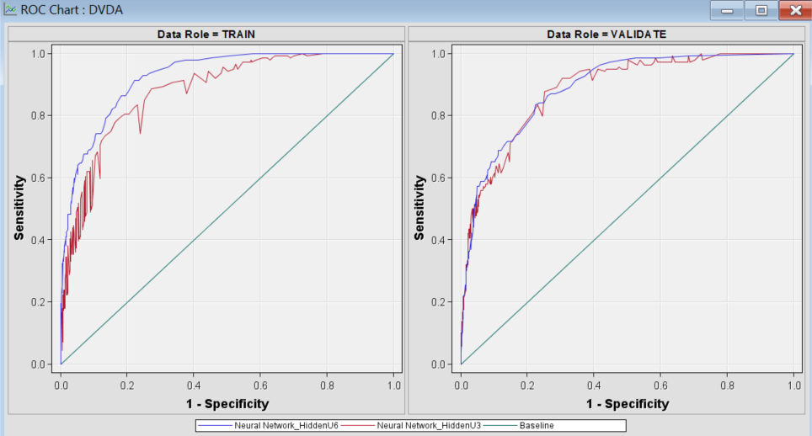
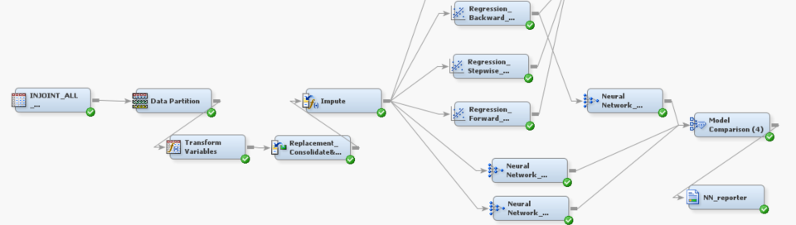
Neural network model comparison
Fit Statistics
Model Selection based on Valid: Misclassification Rate
Train: Valid:
Valid: Average Train: Average
Model Misclassification Squared Misclassification Squared
Node Model Description Rate Error Rate Error
Neural3 Neural Network_HiddenU6 0.11930 0.08120 0.11230 0.09639
Neural2 Neural Network_HiddenU3 0.12332 0.11348 0.14572 0.10212
Neural Neural Network_HiddenU3 0.12601 0.09640 0.13369 0.09827

Slide 21
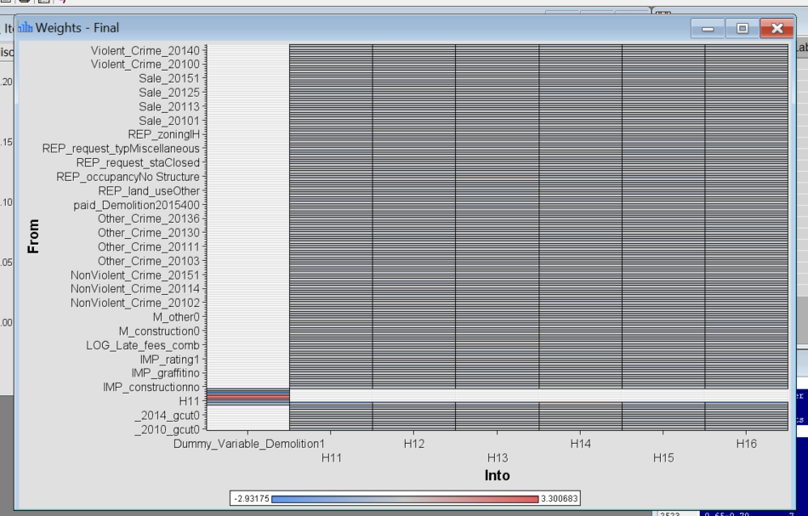
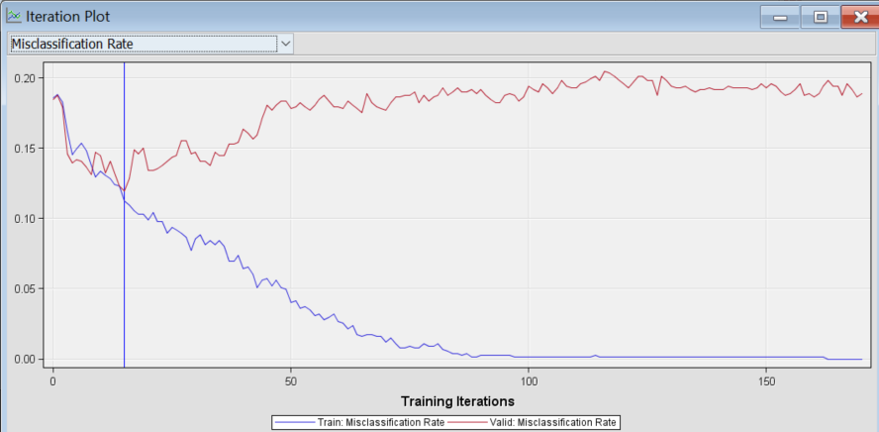
Neural network model weights and parameters
Optimization Results (1009 parameter estimates)
Parameter Estimates
Gradient
Objective
N Parameter Estimate Function
1 LOG_Late_fees_comb_H11 0.375179 -0.000015183
2 LOG_Ori_amt_comb_H11 0.546825 -0.000017382
3 LOG_Paid_comb_H11 -0.001867 -0.000003554
4 LOG_late_fees_Sanitation2015_H11 0.431722 -0.000001962
5 LOG_ori_amt_Sanitation2015_H11 0.313230 -0.000002099
6 LOG_ori_amt_Weed_Cutting2015_H11 0.015622 0.000007933
7 LOG_Late_fees_comb_H12 1.022528 0.001136
8 LOG_Ori_amt_comb_H12 -0.970118 0.001020
9 LOG_Paid_comb_H12 -0.422006 0.000215
10 LOG_late_fees_Sanitation2015_H12 -0.787159 0.000030951
11 LOG_ori_amt_Sanitation2015_H12 0.649889 0.000014891
12 LOG_ori_amt_Weed_Cutting2015_H12 0.268840 -0.000654
13 LOG_Late_fees_comb_H13 1.087307 0.000350
14 LOG_Ori_amt_comb_H13 -0.409573 0.000466
15 LOG_Paid_comb_H13 -0.118317 -0.000117
16 LOG_late_fees_Sanitation2015_H13 -0.275618 -0.001322
17 LOG_ori_amt_Sanitation2015_H13 -0.046507 -0.000981
18 LOG_ori_amt_Weed_Cutting2015_H13 1.505582 0.000233
19 LOG_Late_fees_comb_H14 0.282938 0.000040119

Slide 22
Key learning
Never assume the datasets are accurate or clean from any source without examining them.
The Identification of the related variables and reduction to the unnecessary data complexity will help the SAS EM perform better---- it is not a good idea to shovel the data into EM and rely on it to perform well.
The output log file provides a thorough documentation with statistic calculation, model parameters and iteration steps, which are helpful to trouble-shooting model optimization. Therefore, it is worth to learn how to read the file and understand certain amount of those statistics .

Slide 23
Thank you for your attention!

